Slide 1
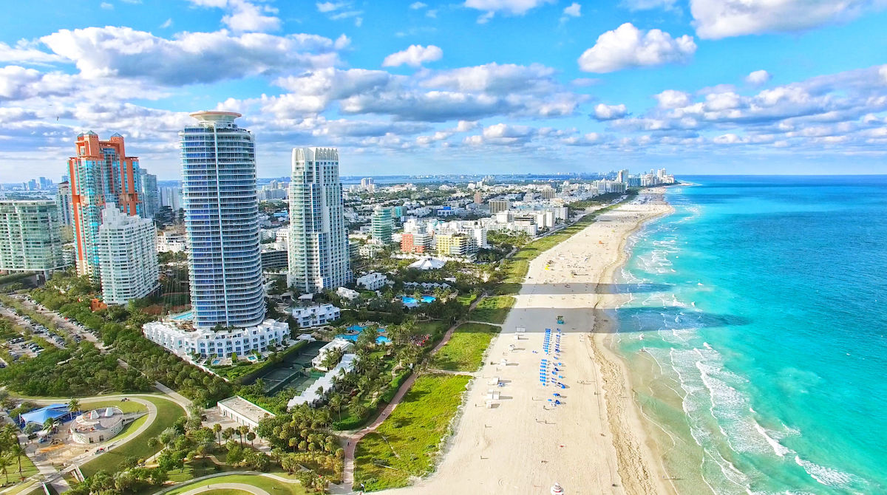


Why Miami Property Prices Have Been Rising Nonstop ?

Slide 2
MDC Property Value Analysis
Population &
Demographics
Economics
Sales Analysis
Tax Implication
Buyer’s origin
Type of sales
Population Growth
Rent values and behavior
Interest rates
Leading Indicators

Slide 3
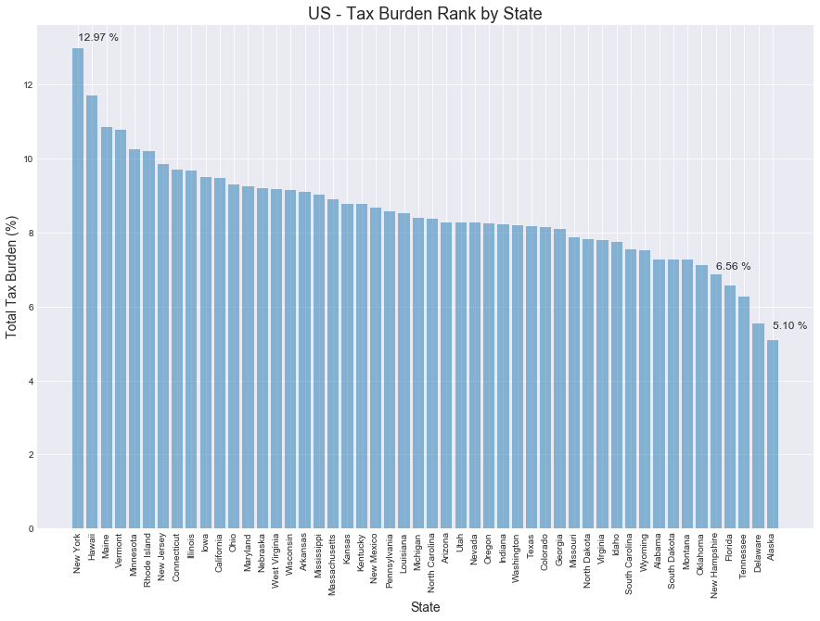
Interest from high earners in tax-burdened states continue to drive demand in the South Florida real state market

Slide 4
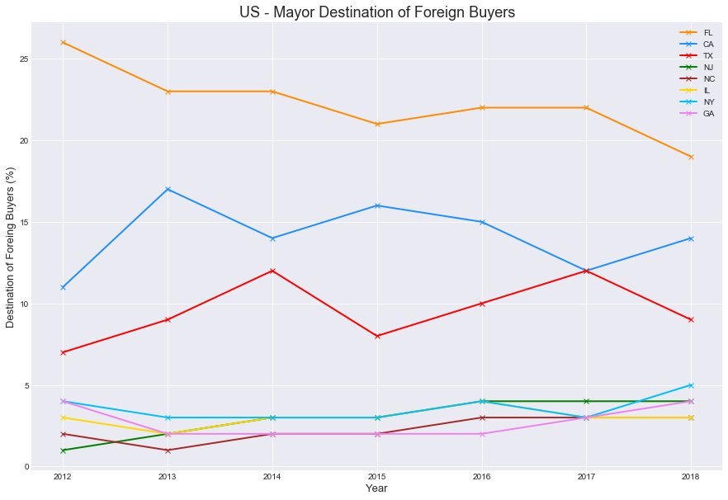
Florida have been the top destination, accounting for 22 percent in average of foreign buyer purchases.

Slide 5
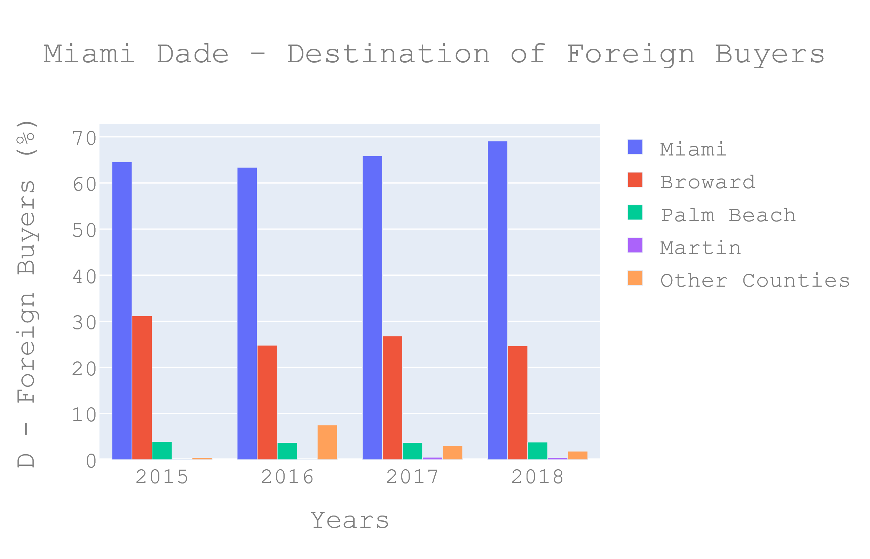
Miami Dade County have been the top destination, above 60% percent of foreign buyer purchases.

Slide 6
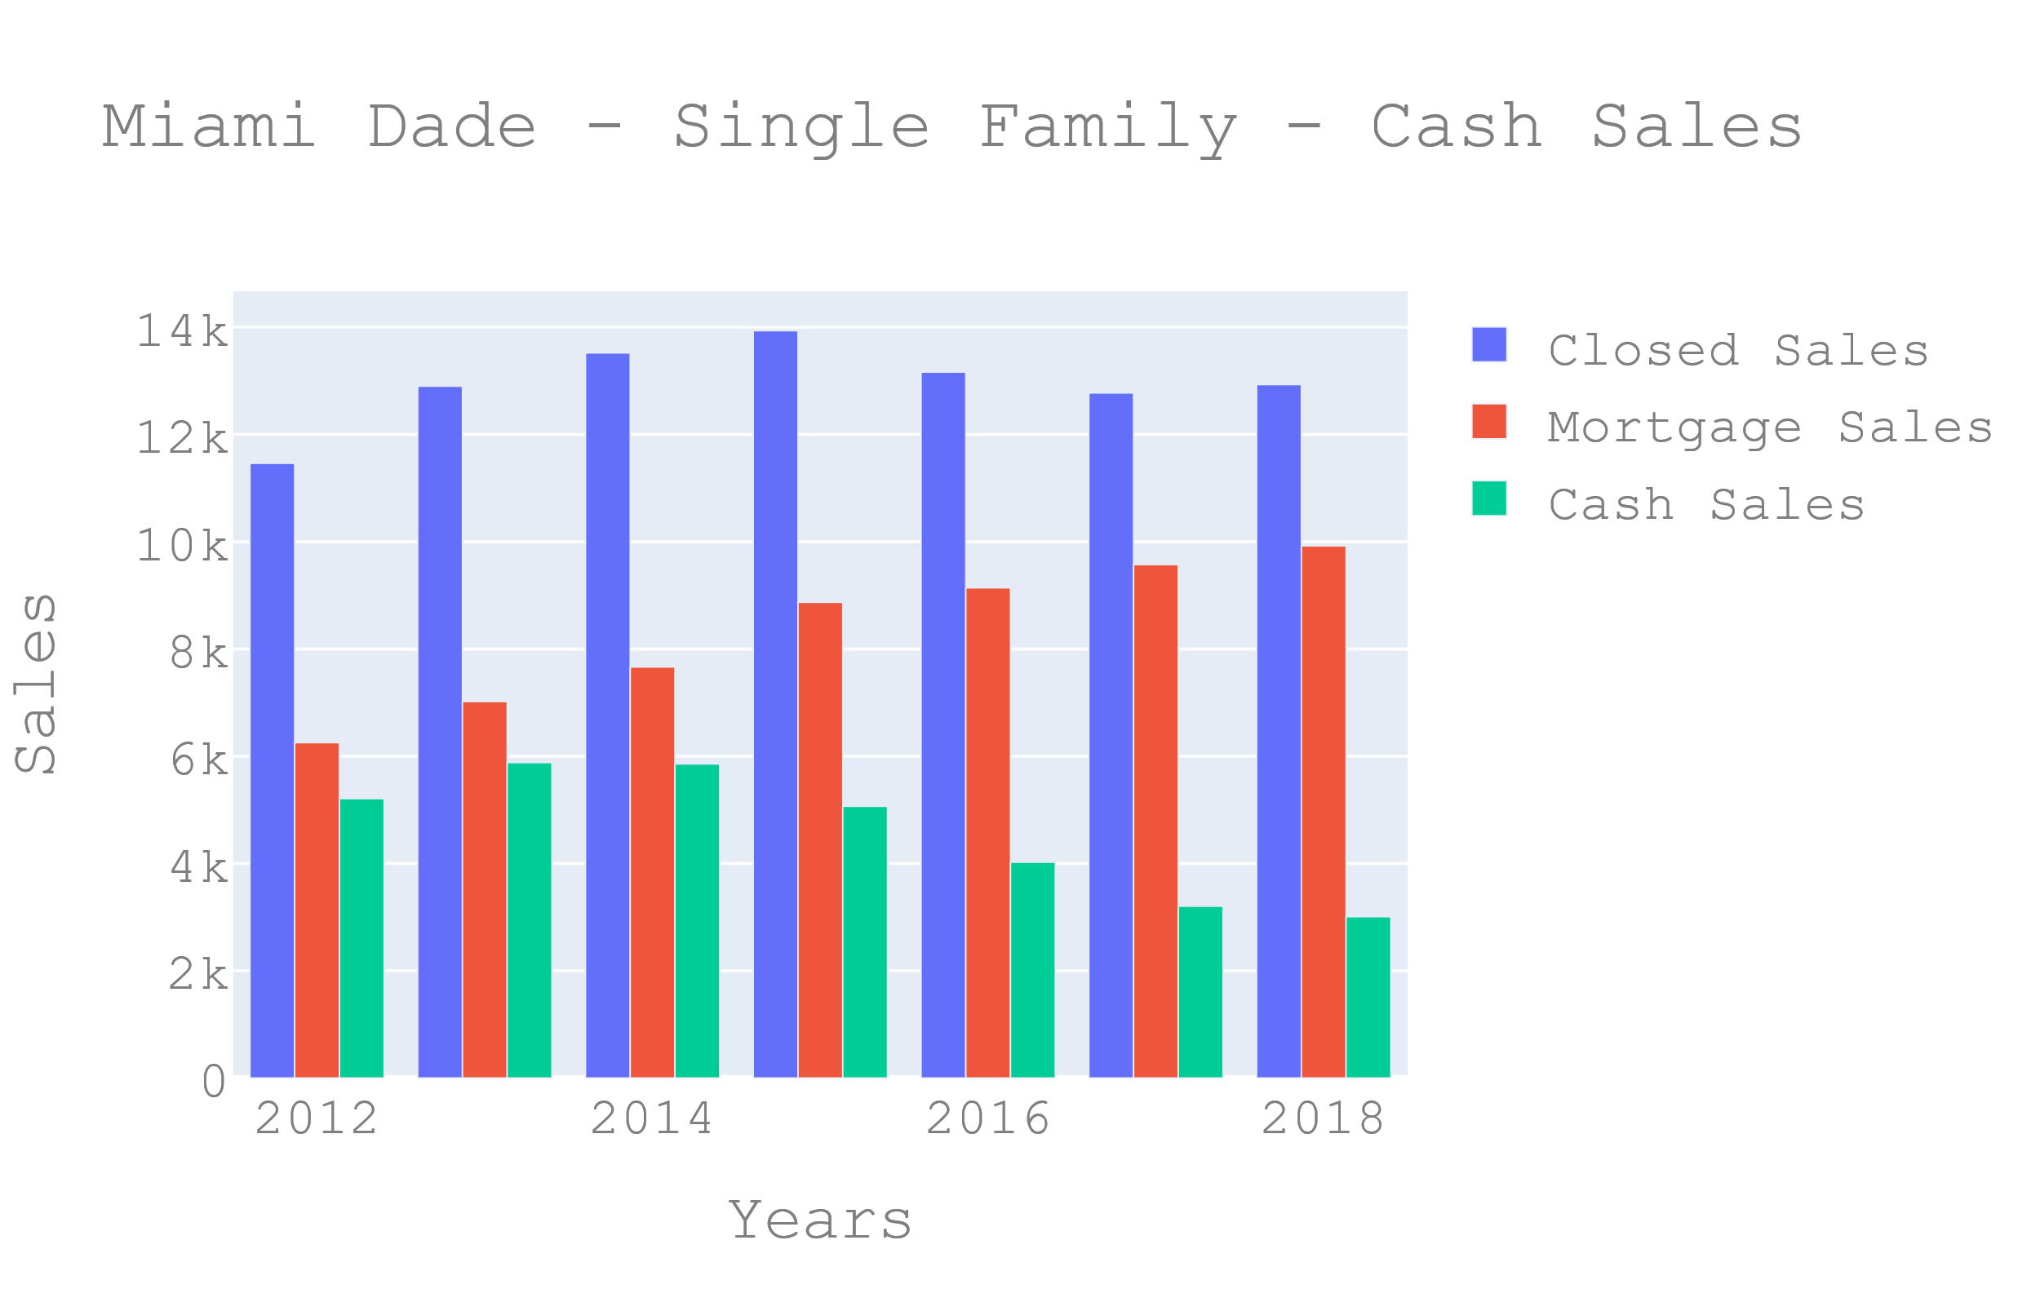
Cash sales in Miami have been higher than the national average of about 16% reflecting Miami’s popularity with international home buyers, and investors who tend to purchase properties in all cash

Slide 7
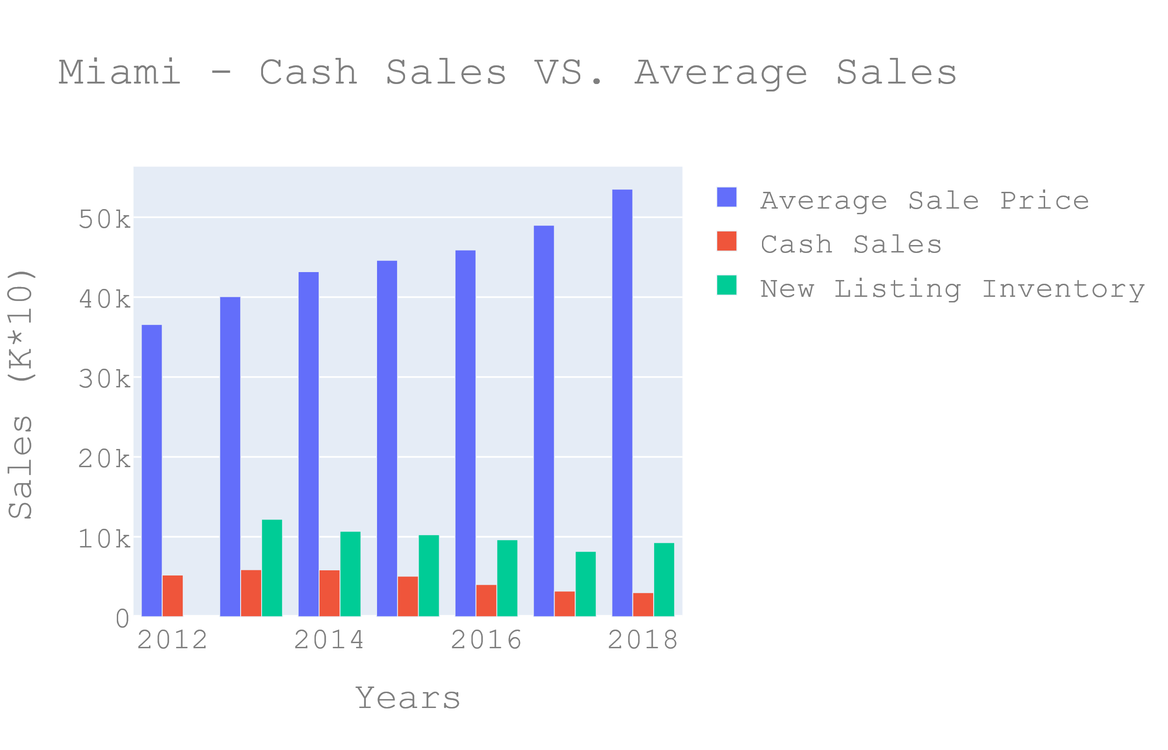
Even though there is decrease in the cash sales in Miami, the average sale price have been consistently rising due to a decrease in new listing inventory.

Slide 8
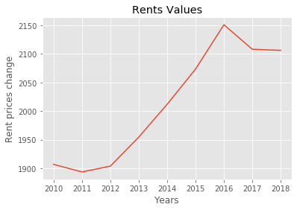
Rent prices: Trend and Behavior
Foreign buyers have withdrawn due to the strong US dollar, and rent values in SF have been in decline since 2016. However, the prices are not changing their trend.

Slide 9
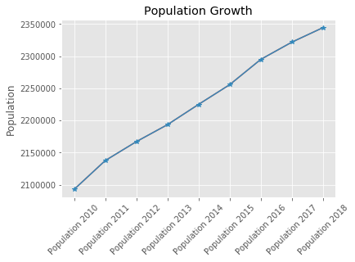
Population Growth in South Florida
Population growth in SF is the higher in the country. Low taxes, good weather, and a stable economy is attracting near 900 people a day.

Slide 10
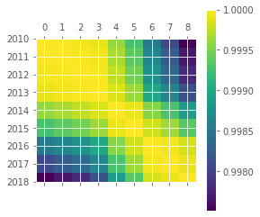
Correlation between housing values and population growth
With a correlation of 0.93, it seems like the trend in population growth in SF is pushing the prices higher.

Slide 11
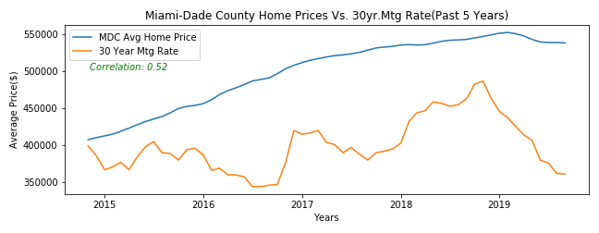
Interest Rate for the past 5 years
There is a fairly medium correlation between the low rates and the increase in the average home prices in MDC.

Slide 12
Leading Economic Indicators
The most relevant leading indicators of our economy that influence home market values are employment data. When employment is strong there is more power of acquisition and also drives up the consumer confidence which accounts to two thirds of our economy. Another important indicator is the manufacturing activity since manufacturing is a key indicator since developers require manufacturers to produce more materials to build. Government policies and subsidies is also another factor in properties. Tax credits, deductions and subsidies are some of the ways the government can temporarily boost demand for real estate. Being aware of current government incentives can help you determine changes in supply and demand and identify potentially false trends.

Slide 13
Conclusions
There is a medium correlation between interest rate and the average home prices increase in MDC during the past five years. Therefore it can be concluded that there is some relation between both them but there are other factors more determinant to prove our hypothesis.
Florida’s tax burden rank is definitely a factor driving demand in Miami’s real state.
Miami top destination for International buyers have been boosting the property values.
Miami cash sales in conjunction with a reduction in the property supply have increased the property values as cash buyers tend to pay over the asking price.
Foreign buyer and rent prices have contracted in the last three years. However, prices keep going up.
Strong correlation between home prices and the population growth show the impact in the SF booming economy by increasing Real Estate prices.

Slide 14
Data Sources: https://www.zillow.com/research/data/ https://www.miamirealtors.com/ https://www.nar.realtor/ https://www.data.gov/ https://www.wallethub.com/

